Slide 1
Ch.2 My travel experience
P.5

Slide 2
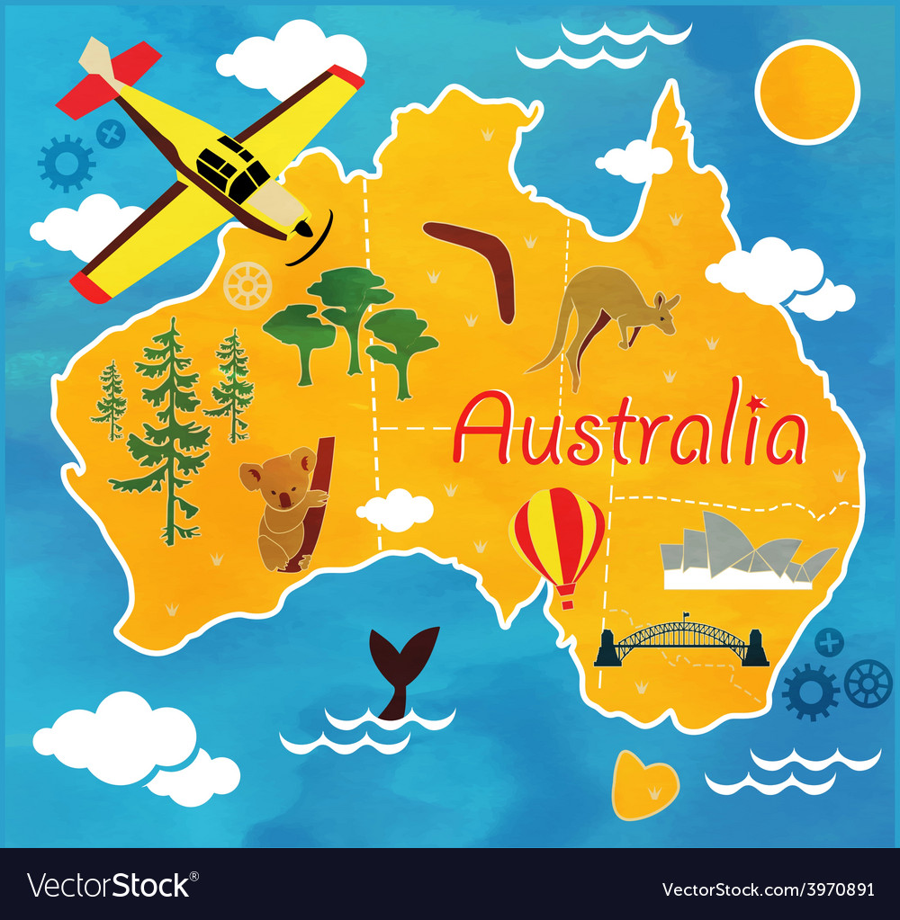
Ling says:
Hi everybody! Sorry I haven’t chatted for ages. I’ve been on holiday.
I went to Australia with my parents last week. It was brilliant!
We saw kangaroos and koalas.

Slide 3
Kangaroo mothers keep their babies in a pouch (a pouch is like a pocket) on the front of their bodies. The babies are tiny and cute!

Slide 4
Koalas are very lazy---they sleep for 19 hours a day! Have you ever seen a koala or a kangaroo?

Slide 5
Name:________________
Yes, I have.
flown

Slide 6
Miss Lo的感想:
經過上次英文的句子讀音， 老師要稱讚以下的同學， 他們擁有勇氣地去朗讀， 雖然發音仍需加強但非常認真: 獲稱讚的同學為:
Cyrus、Johnny、Ben、Venus 希望其他同學再繼續努力!!!
Miss Lo

Slide 7
今個星期的功課:
1. 需要熟讀及翻譯以上的句子，并圈出句子中難以朗讀的單詞 2. 然後試讀後錄音交回給老師 3. 請完成上面的工作紙，你可找英文書Ch.2 →P.7句子為例句，
同學明白後，需回答工作紙上的答案
EX: Have you ever visited a cave?
Yes, I have.
No, I haven’t

