Slide 1
Ch.2 My travel experience
P.5

Slide 2
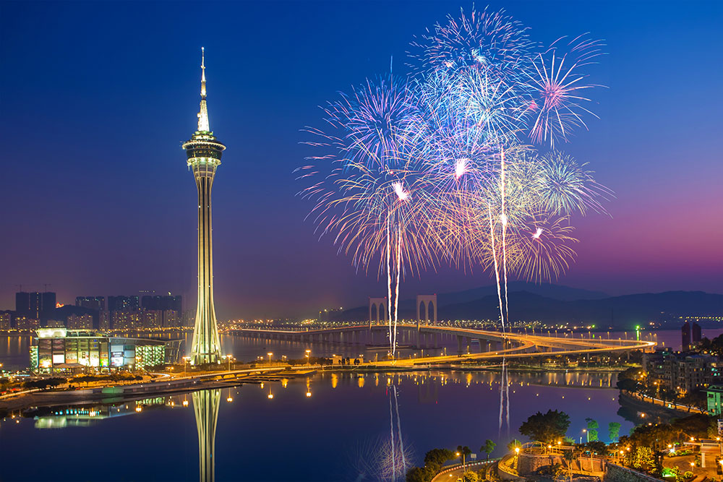
Tony says:
I’ve never heard of that before. It sounds amazing! How many times have you watched the fireworks competition?

Slide 3
Apple says:
I’ve watched it many times. It’s one of my favorite events in Macau.

Slide 4
Ling says:
I’ve only been to Macau once. I’d love to see the fireworks competition.

Slide 5
Tony says:
Me too. Let’s all go together next year.

Slide 6
Apple says:
Great! I can’t wait to see you both.

Slide 7
今個星期的功課:
1. 需要熟讀及翻譯以上的句子，并圈出句子中難以朗讀的單詞 2. 然後試讀後錄音交回給老師 3. 小朋友們請上網找出一些澳門的名勝古蹟及如圖一樣畫出來。
4. 做I.P.→Ch.2(P.5、P.6)
5. 請小朋友們熟讀Ch.2課文。
加油!!辛苦了~

Slide 8
Homework:

Slide 9
References :
You can choose three place to describe for your homework.

