Slide 1
Ch.1 Holiday Plans
02~06/03/2020 English

Slide 2
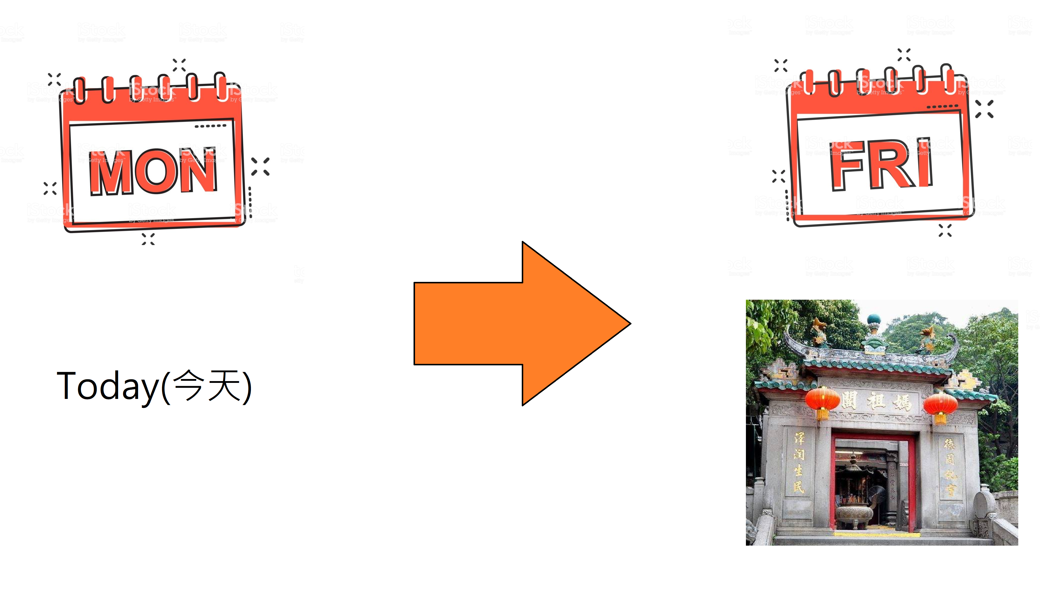
We use the future tense(將來式) to talk about future activities and events(未來所發生的事).
We will go to a temple on Friday.

Slide 3
We’ll go to a tower on Saturday.
We’ll = We will

Slide 4
We can use ‘Where’(哪裏) and ‘What’(甚麼) to ask question in the future tense.
A: Where will we go on Saturday?
B: We’ll go to a tower.
A: What will we go there?
B: We’ll look at the beautiful views.

Slide 5
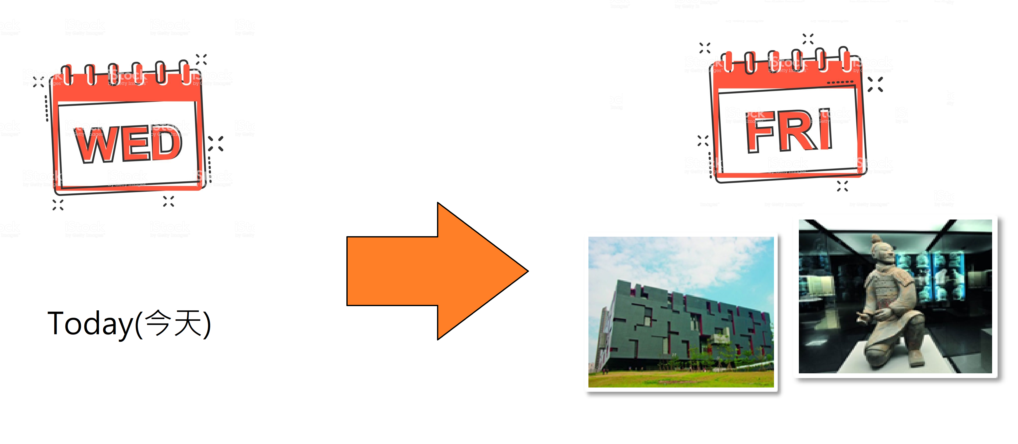
A: Where will we go on Friday?
B: We’ll go to a museum.
A: What will we go there?
B: We’ll look at the statues.

Slide 6
Fill in the blanks.
MON | TUE | WED | THU | FRI | SAT | SUN
zoo
TODAY
A: Where will we go tomorrow?
B: _______ (go) to the zoo tomorrow.

Slide 7
Fill in the blanks.
MON | TUE | WED | THU | FRI | SAT | SUN
zoo
TODAY
A: Where will we go tomorrow?
B: We’ll go (go) to the zoo tomorrow.

Slide 8
Fill in the blanks.
MON | TUE | WED | THU | FRI | SAT | SUN
Hill – ride on the cable car
TODAY
A: Where _____ we ____ (go) on Saturday?
B: _______ (go) to a hill.
A: __________ we _____ (do) there?
B: ________ (ride) on a cable.

Slide 9
Fill in the blanks.
MON | TUE | WED | THU | FRI | SAT | SUN
Hill – ride on the cable car
TODAY
A: Where will we go (go) on Saturday?
B: We’ll (go) to a hill.
A: What will we do (do) there?
B: We’ll (ride) on the cable car.

Slide 10
Let’s read the sentences together.(讀句子)
1. Where will we go on Monday? We’ll go to a temple.
2. What will we do there? We’ll look at the statues.
3. Will we feed the animals? No, we won’t. We’ll look at the animals

Slide 11
Homework(作業)，使用草書抄寫3句句子各4次， 完成後請拍照上傳。
範例影片

Slide 12
